Slide 1


Training Neural Network Part 2
Junhong Kim
Korea University
{Junhongkim@korea.ac.kr}

Slide 2
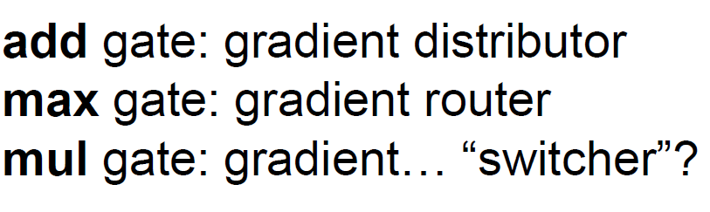
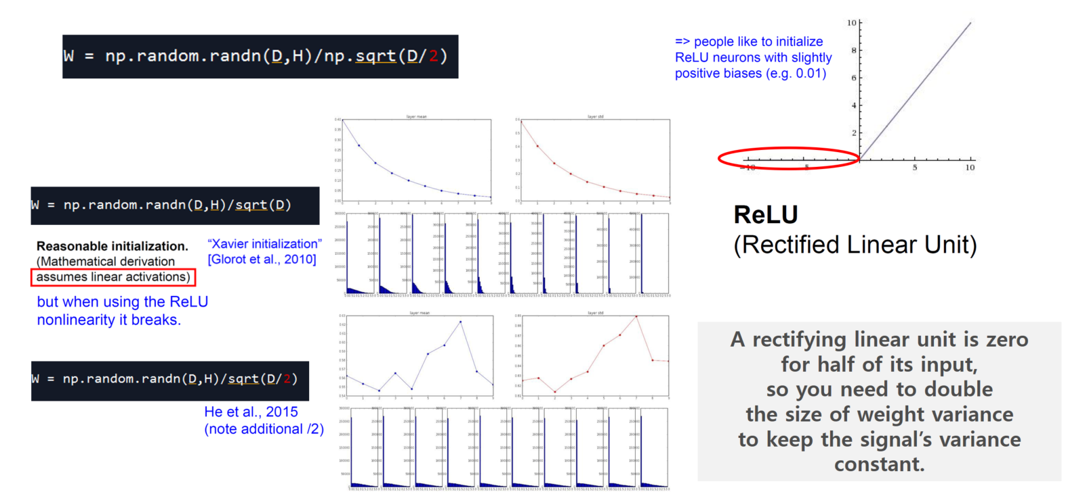
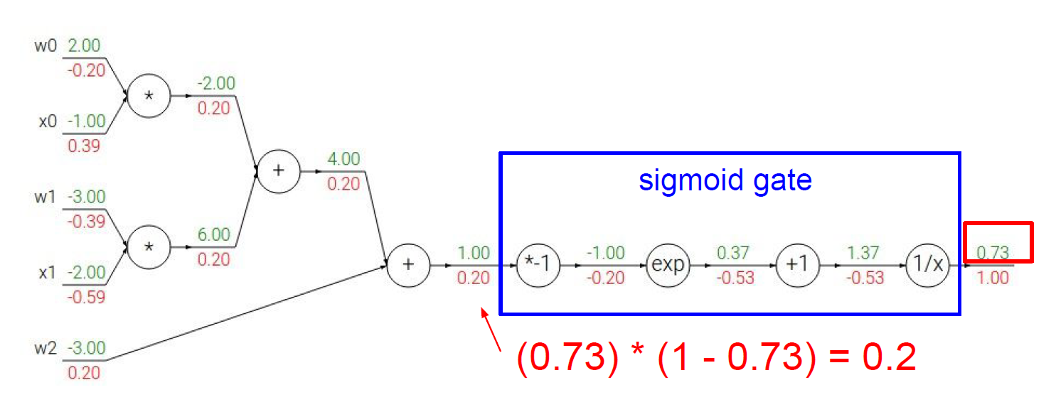
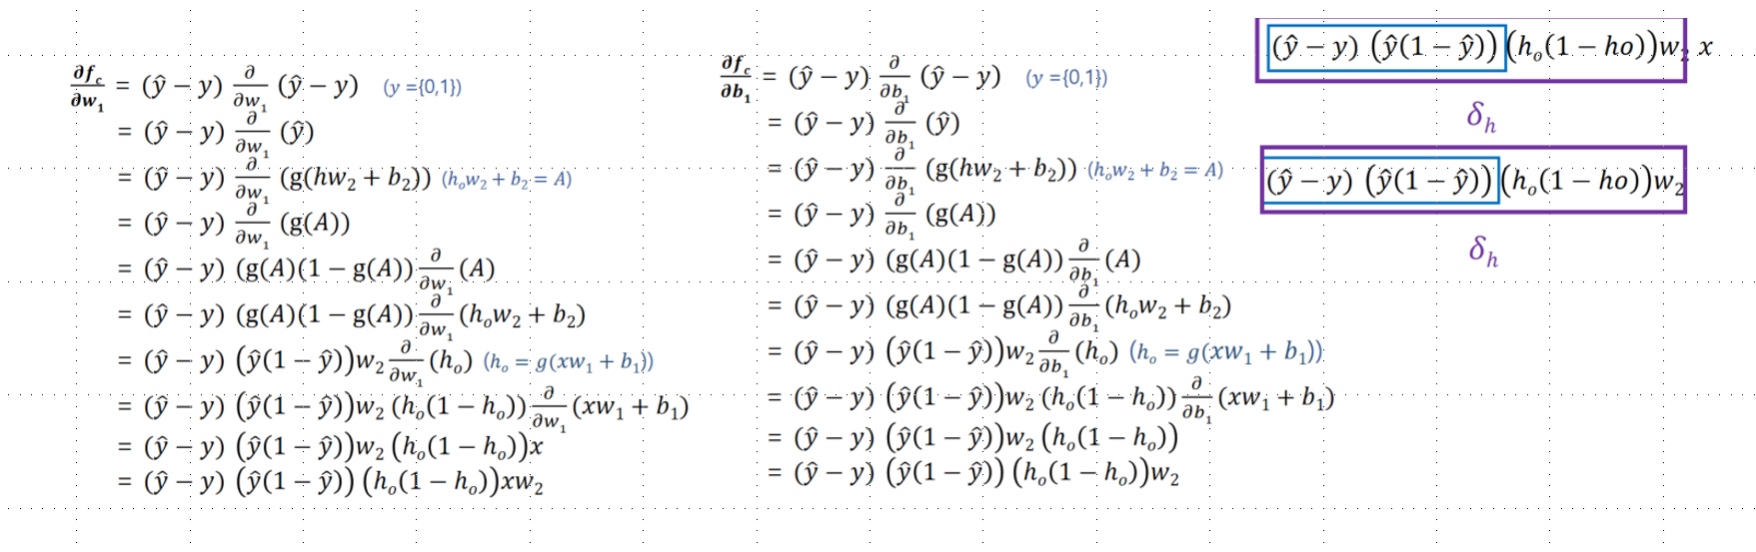
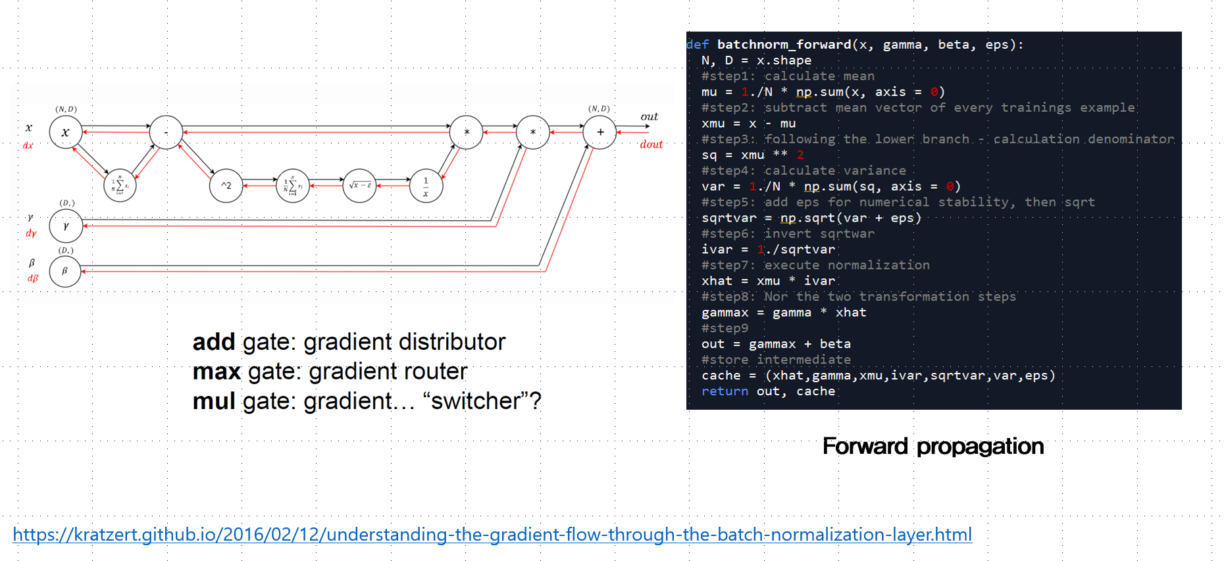
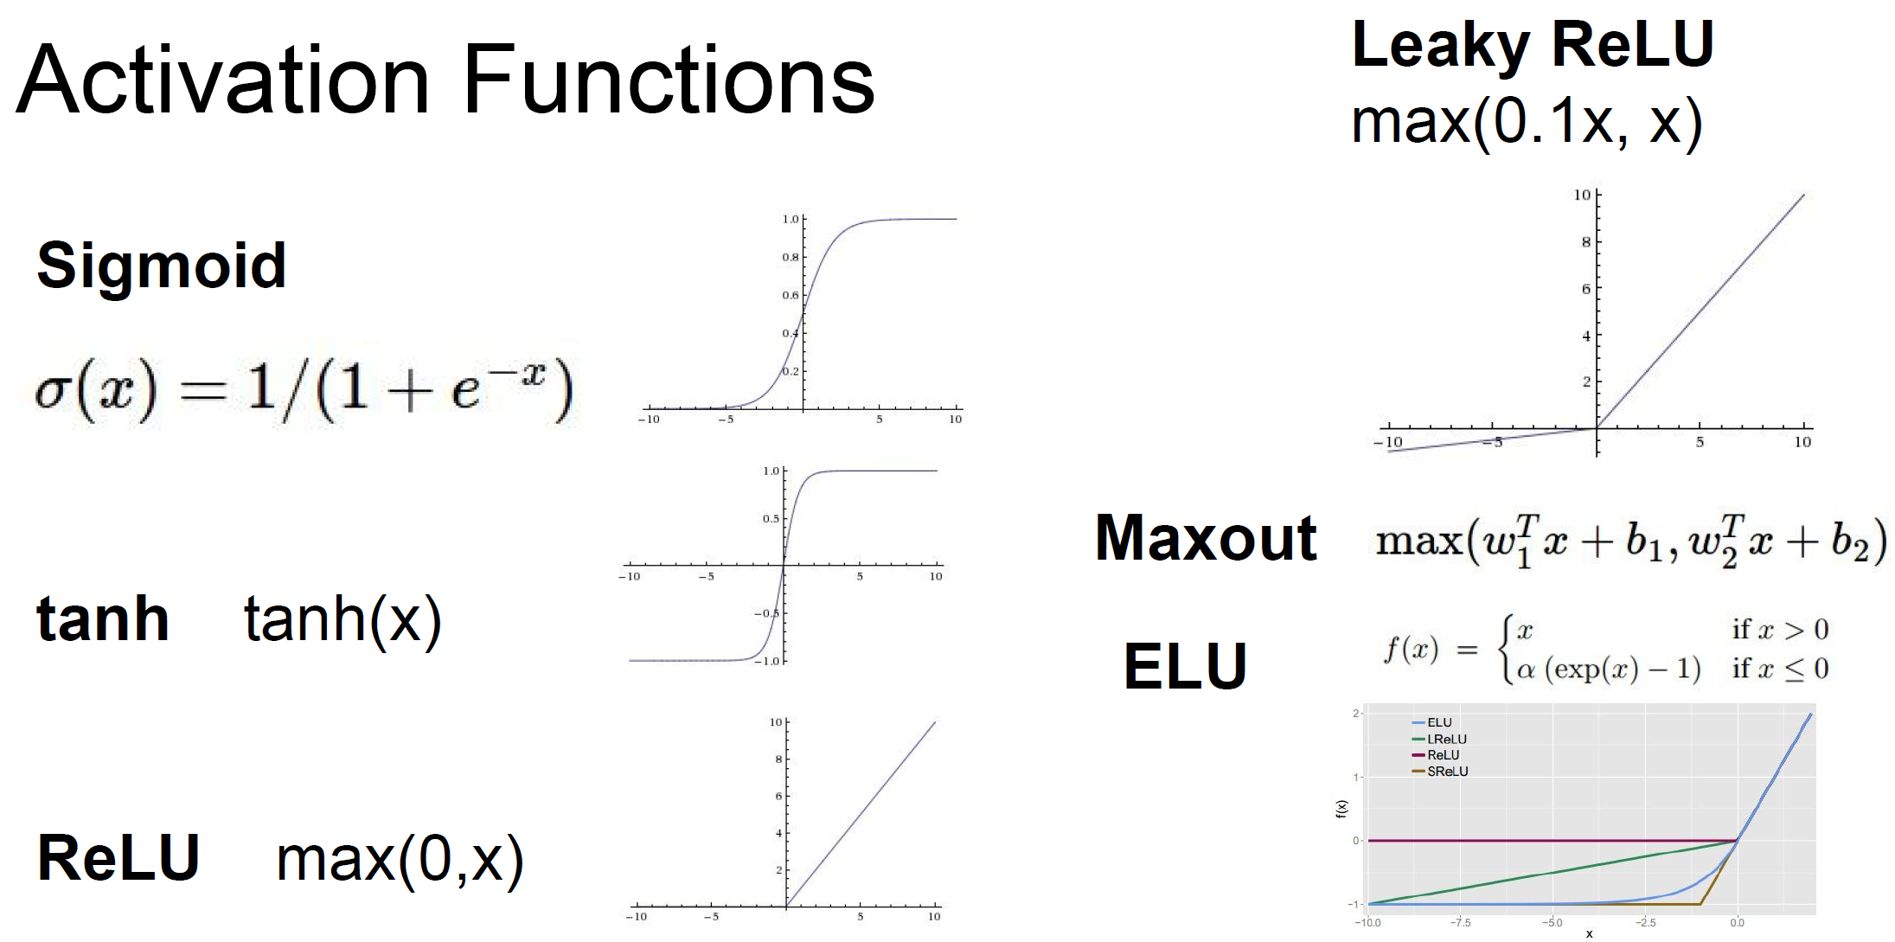
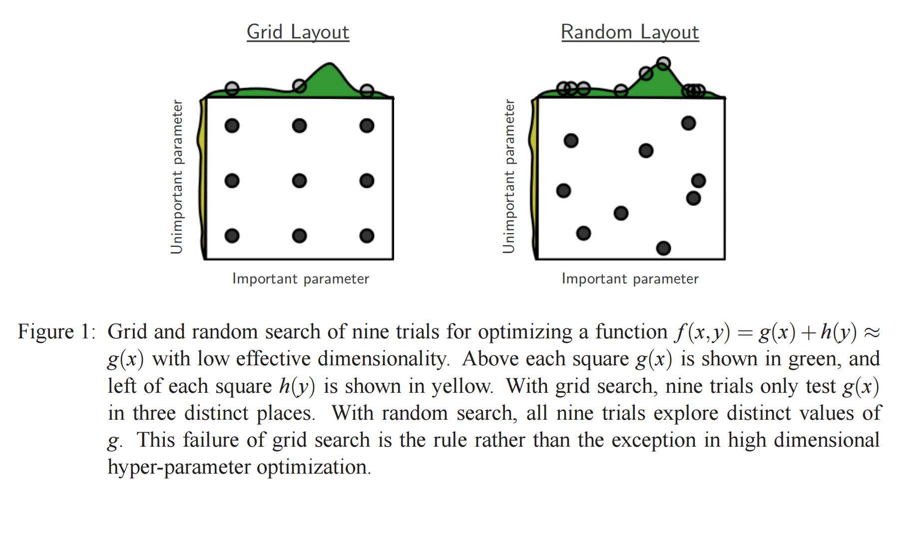
Previously
Warm up
Simple example
Weight Initialization
Gate network
Backpropagation
(chain-rule)
Batch
Normalization
Activation
Funtions
Hyperparameter Optimization

Slide 3
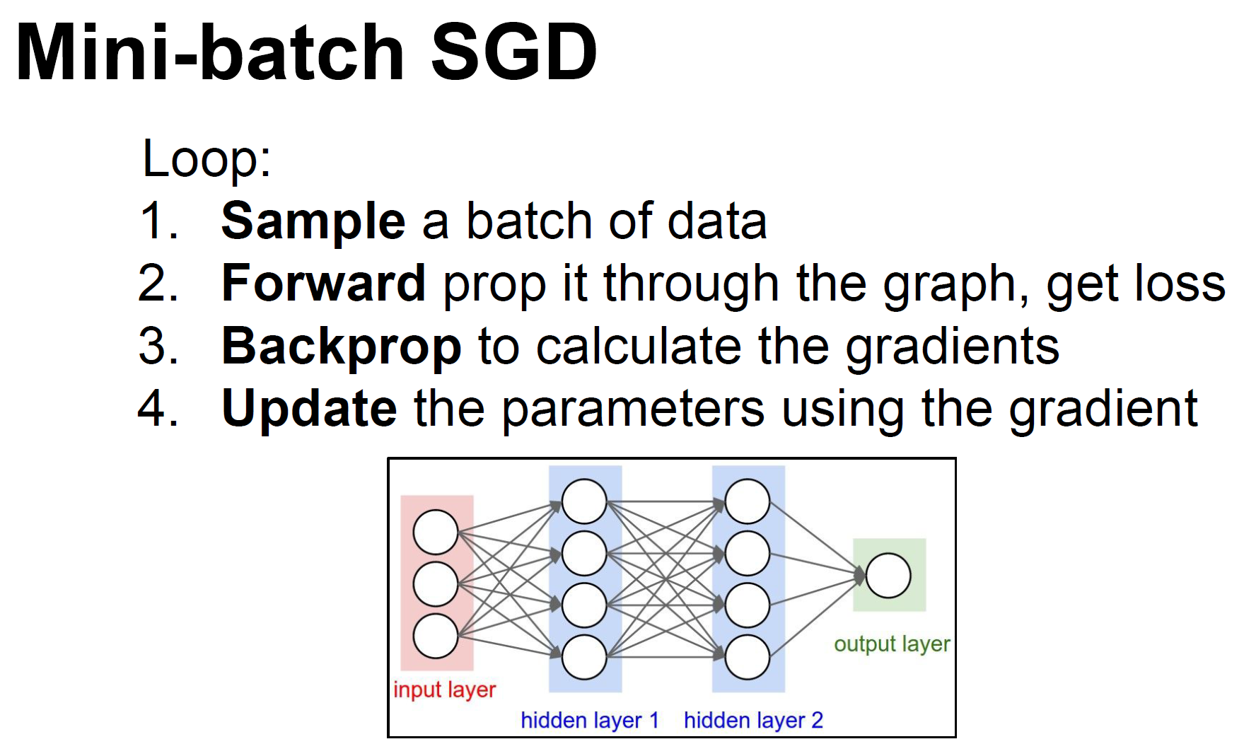
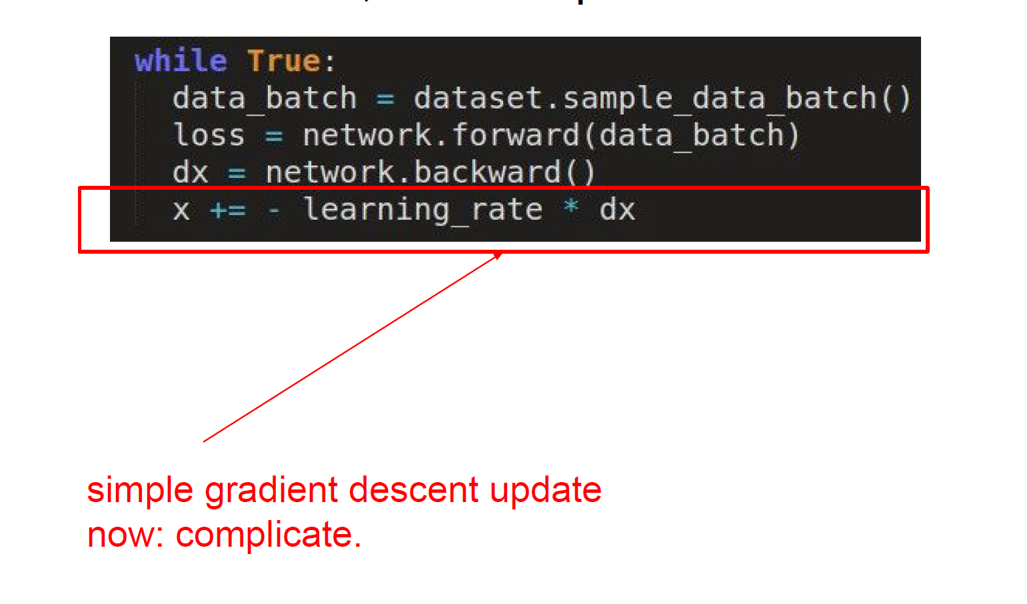
Previously
Weight learning loop

Slide 4
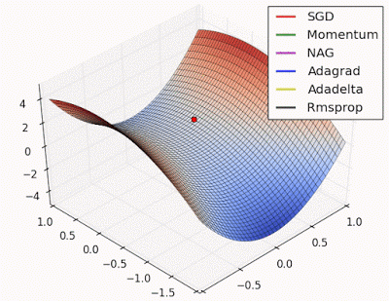
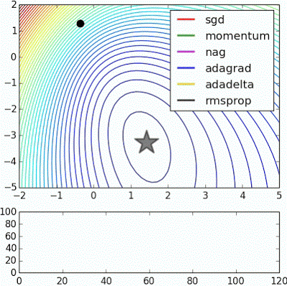



Parameter Updates
Visualization of optimal point each different method
Long valley
Beale’s function
Noisy moons
Saddle point
http://www.denizyuret.com/2015/03/alec-radfords-animations-for.html

Slide 5
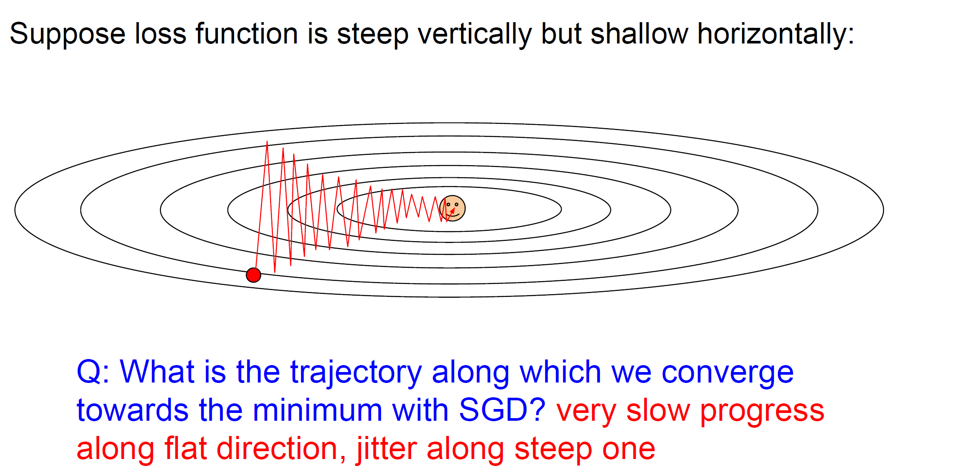
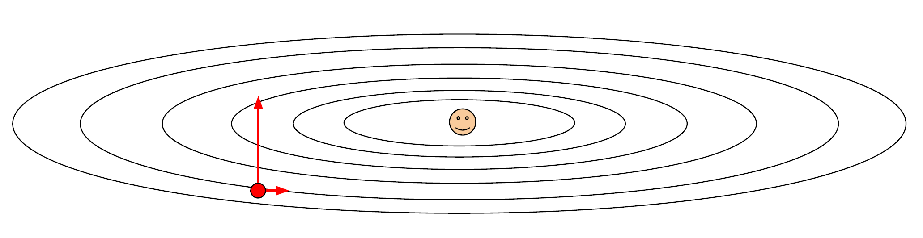
Parameter Updates – Stochastic Gradient Descent
Lack of SGD
SGD :<
Long valley

Slide 6
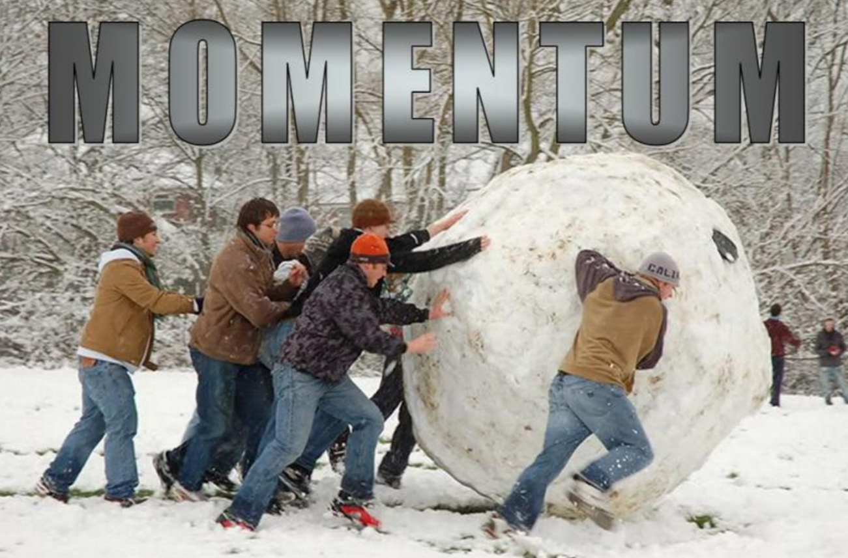
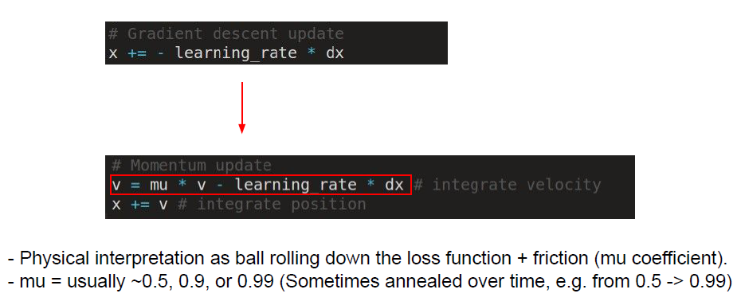
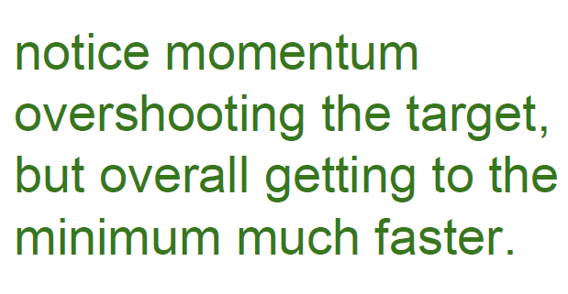
Parameter Updates - Momentum
Momentum update ; Initialization velocity is ‘zero’

Slide 7

Parameter Updates - Momentum
Momentum update ; Initialization velocity is ‘zero’

Slide 8
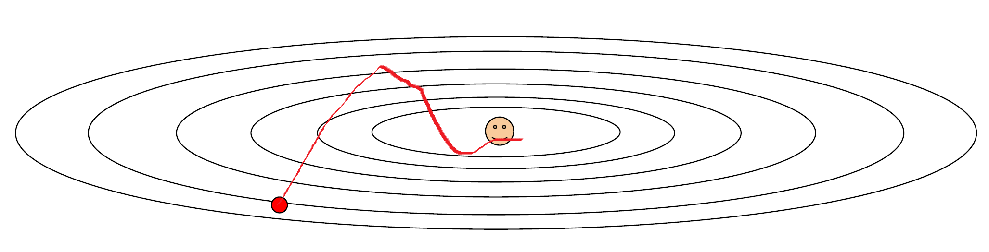
Parameter Updates - Momentum
Momentum update ; Initialization velocity is ‘zero’
SGD
Momentum

Slide 9
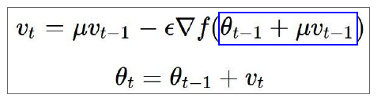

Parameter Updates – Nesterov Accelerated Gradient
Nesterov Accelerated Gradient ; nag
When we optimize convex function, Nesterov Accelerated Gradient method always better than simple momentum update ☺
Noisy moon (Convex form)

Slide 10

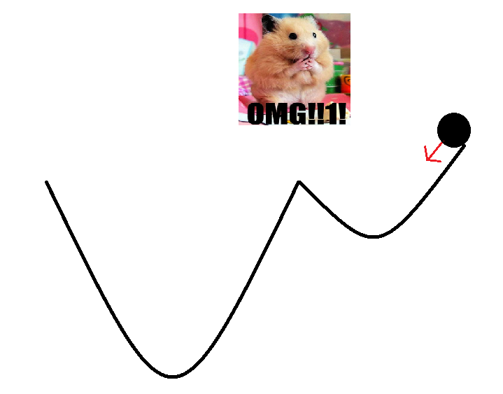
Parameter Updates – Nesterov Accelerated Gradient
Nesterov Accelerated Gradient ; nag
When we optimize convex function, Nesterov Accelerated Gradient method always better than simple momentum update ☺
NAG
momentum
Noisy moon (Convex form)
Non convex?

Slide 11
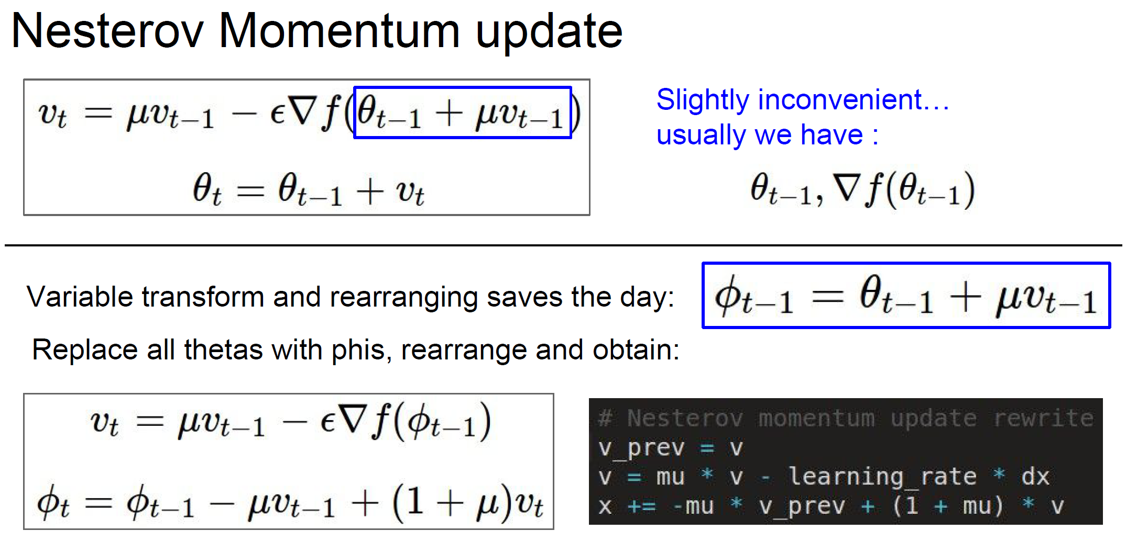
Parameter Updates – Nesterov Accelerated Gradient
Nesterov Accelerated Gradient ; nag
Nesterov : the only difference!

Slide 12
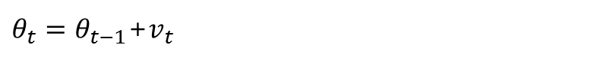
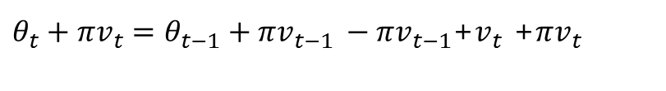
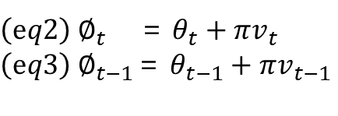
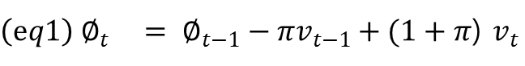
Parameter Updates – Nesterov Accelerated Gradient
Nesterov Accelerated Gradient ; nag
$\left(eq1\right) ∅_{t} = ∅_{t−1}−πv_{t−1}+(1+π$) $v_{t}$
$\left(eq2\right) ∅_{t}$ = $θ_{t}+πv_{t}$
$\left(eq3\right){ ∅}_{t−1}$= $θ_{t−1}+πv_{t−1}$
$θ_{t}+πv_{t}=θ_{t−1}+πv_{t−1 }−πv_{t−1}$+$v_{t}$ +$πv_{t }$
$θ_{t}=θ_{t−1}$+$v_{t}$
Saddle point

Slide 13
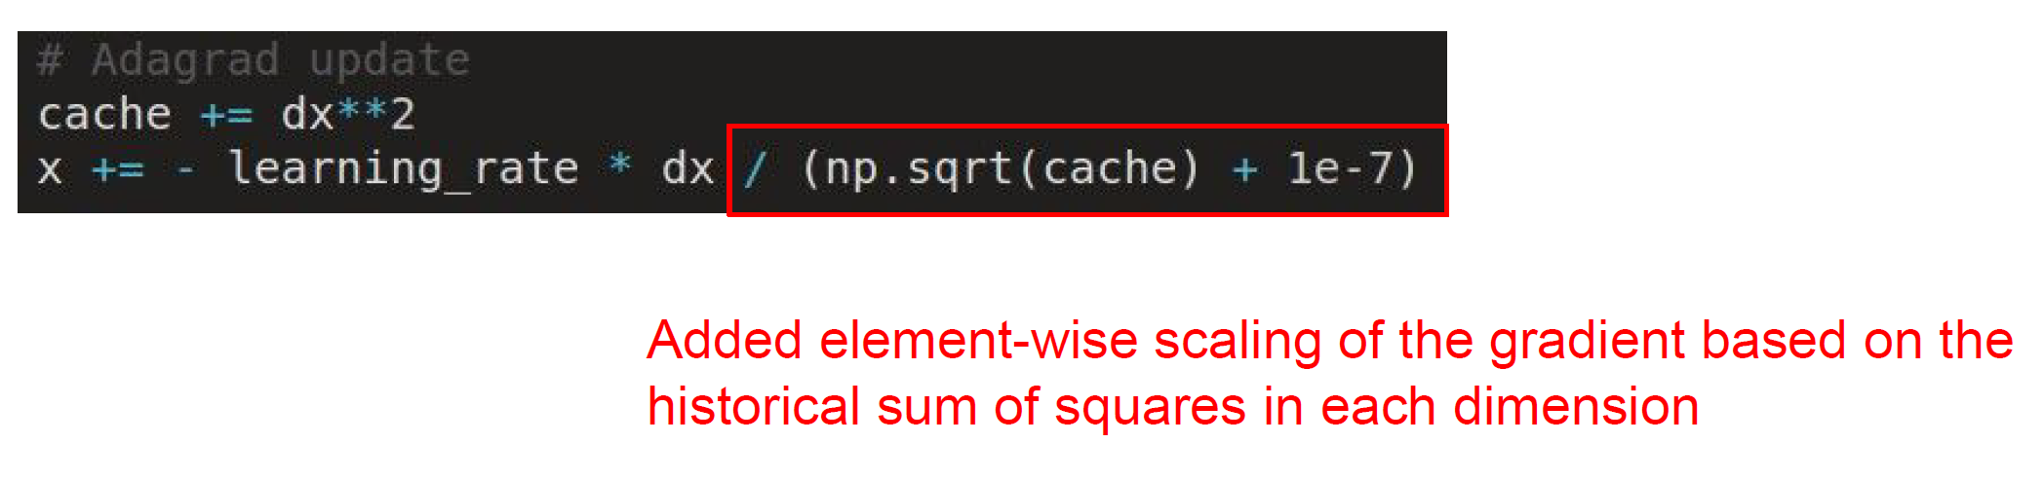
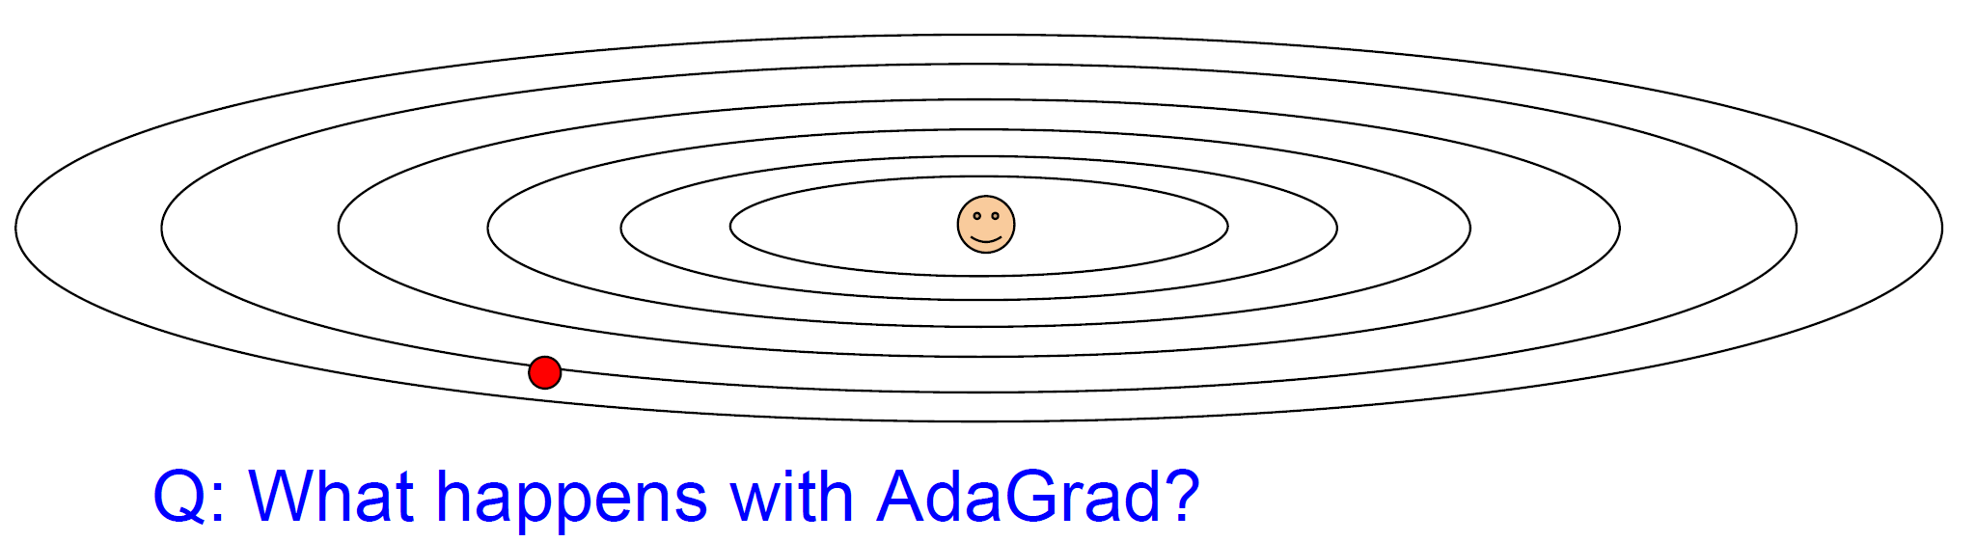
Parameter Updates – AdaGrad
AdaGrad is originally developed convex optimization literature
Cache is always positive value

Slide 14
Parameter Updates – AdaGrad
AdaGrad is originally developed convex optimization literature
Cache is always positive value
correction value

Slide 15
Parameter Updates – AdaGrad
AdaGrad is originally developed convex optimization literature
Cache is always positive value
correction value

Slide 16
Parameter Updates – AdaGrad
AdaGrad is originally developed convex optimization literature
Cache is always positive value
correction value

Slide 17
Parameter Updates – AdaGrad
AdaGrad is originally developed convex optimization literature
Cache is always positive value
correction value
Think about ‘cache’ object!

Slide 18
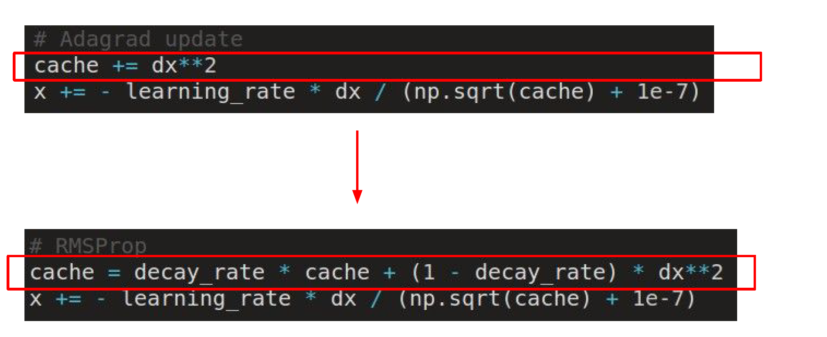
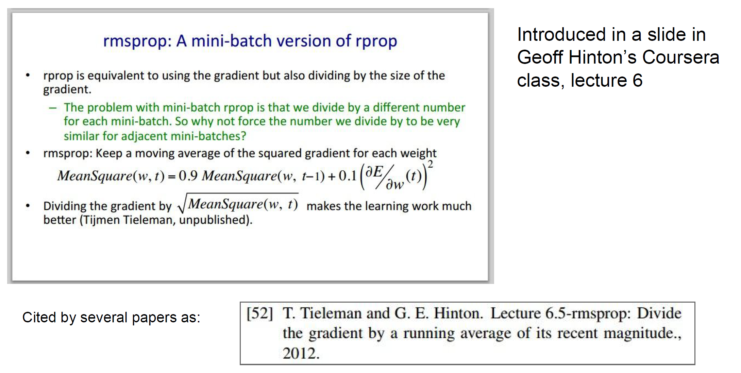
Parameter Updates – RMSProp
‘RMSProp supplements the fast stop problem of ‘Adagrad'

Slide 19
Parameter Updates – RMSProp
‘RMSProp supplements the fast stop problem of ‘Adagrad'
Usually, decay rate set ‘0.99’

Slide 20
Parameter Updates – RMSProp
‘RMSProp supplements the fast stop problem of ‘Adagrad'
Laeking slowly! Cuz decay_rate

Slide 21
Parameter Updates – RMSProp
‘RMSProp supplements the fast stop problem of ‘Adagrad'
[Q] Can we use moving window method for cache?
[A] It takes to too much memory :< Therefore people don’t use in practice

Slide 22
Parameter Updates – RMSProp
‘RMSProp supplements the fast stop problem of ‘Adagrad'
[Q] Can we use moving window method for cache?
[A] It takes to too much memory :< Therefore people don’t use in practice

Slide 23
Parameter Updates – RMSProp
‘RMSProp supplements the fast stop problem of ‘Adagrad'
In this case, RMSProp is overtaken by Adagrad
[Q] Can we use moving window method for cache?
[A] It takes to too much memory :< Therefore people don’t use in practice
Long valley

Slide 24
Parameter Updates – RMSProp
‘RMSProp supplements the fast stop problem of ‘Adagrad'
But not always
[Q] Can we use moving window method for cache?
[A] It takes to too much memory :< Therefore people don’t use in practice

Slide 25
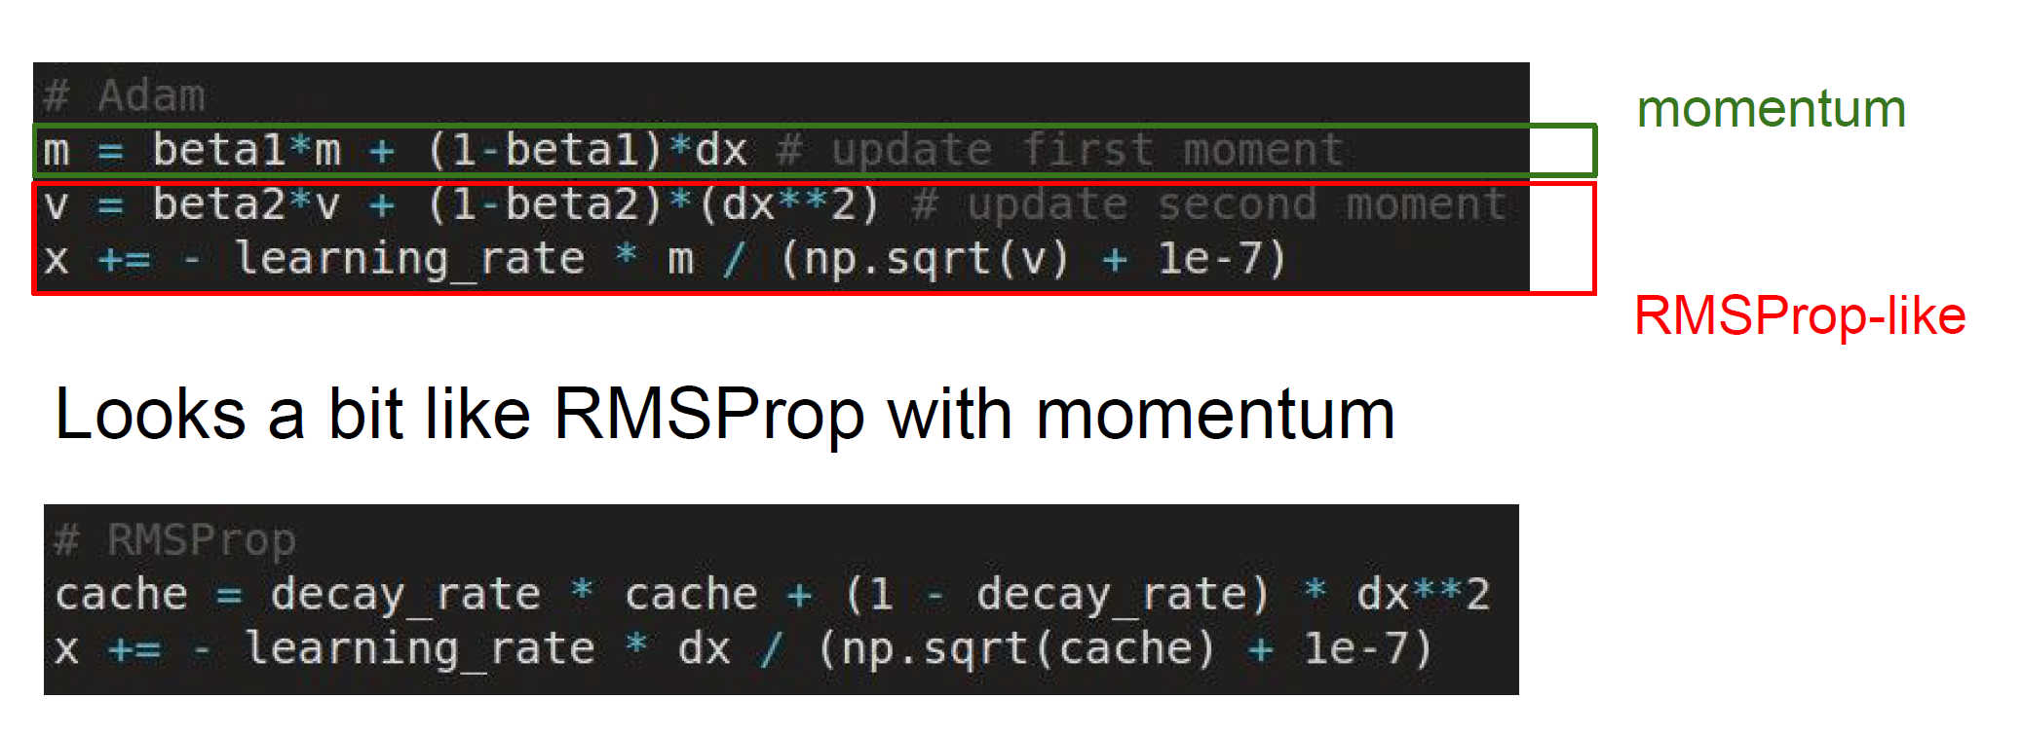

Parameter Updates – Adam
Could you combine RMSProp and Momentum?
Incomplete format

Slide 26
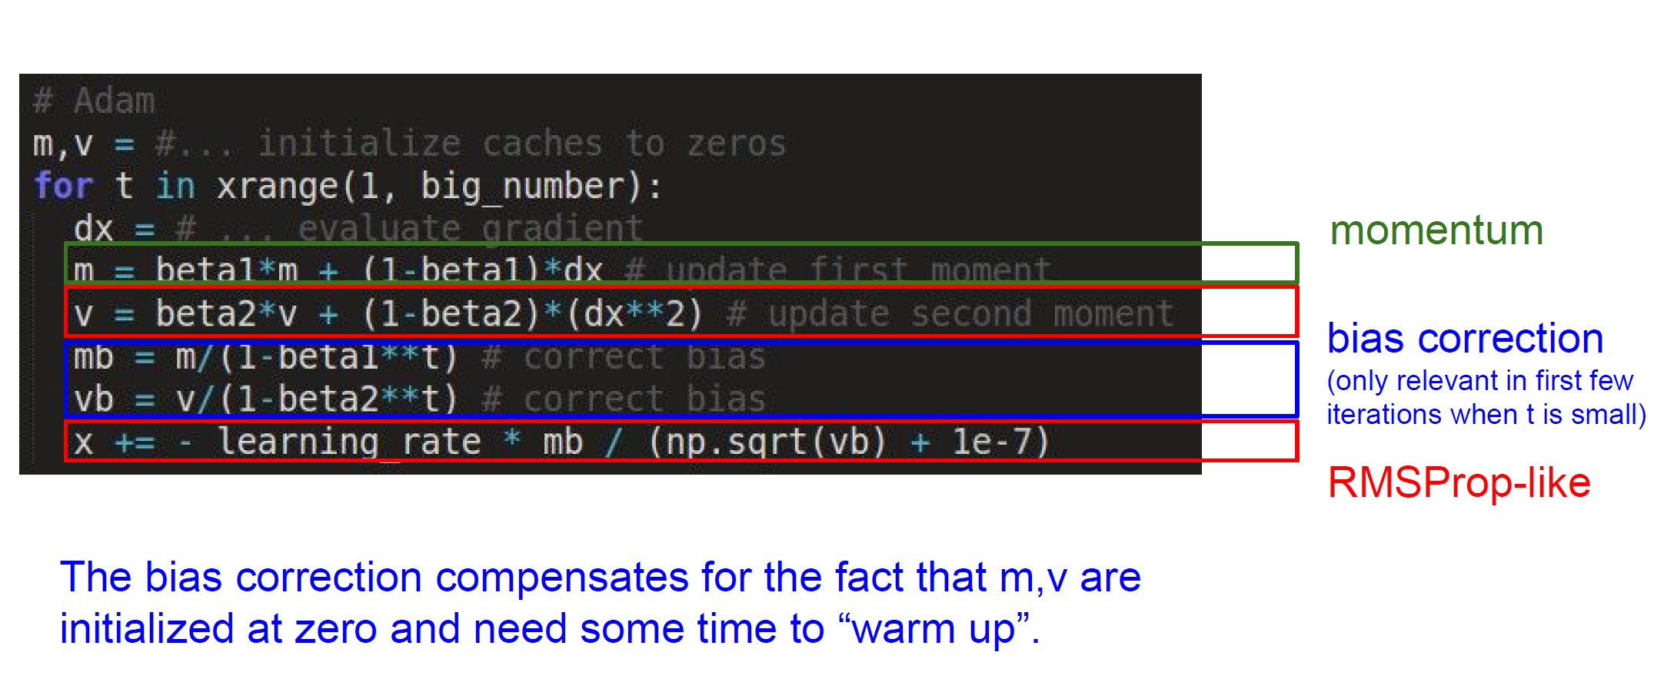
Parameter Updates – Adam
Could you combine RMSProp and Momentum?

Slide 27
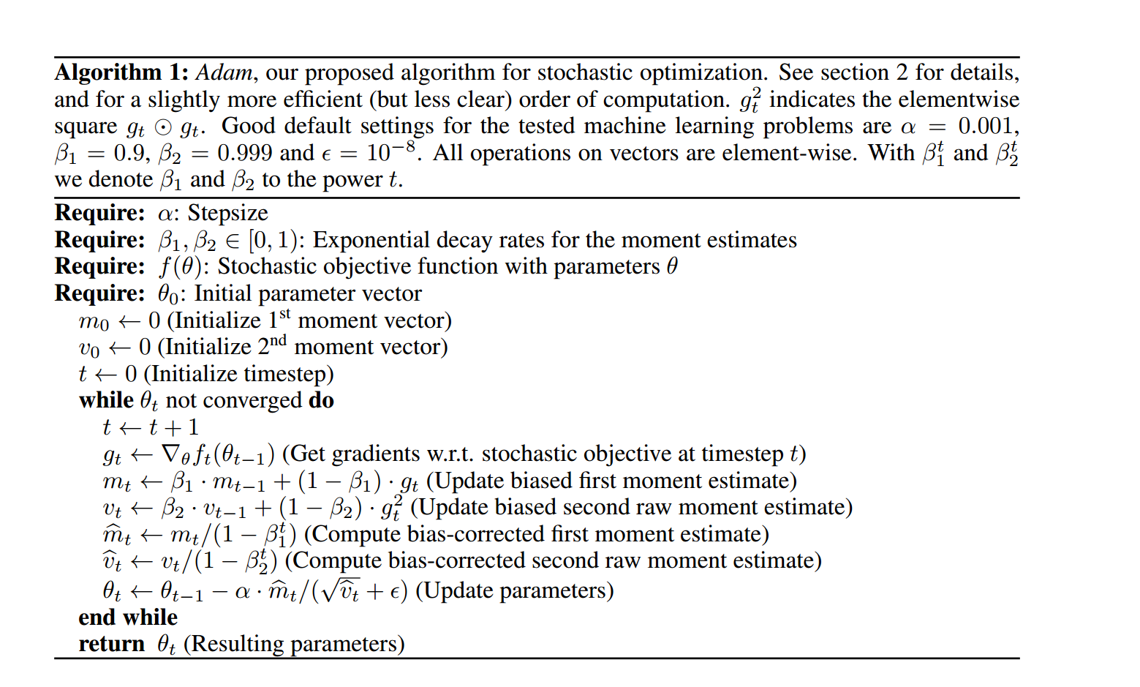
Parameter Updates – Adam
Could you combine RMSProp and Momentum?
Kingma, Diederik, and Jimmy Ba. "Adam: A method for stochastic optimization." arXiv preprint arXiv:1412.6980 (2014).

Slide 28

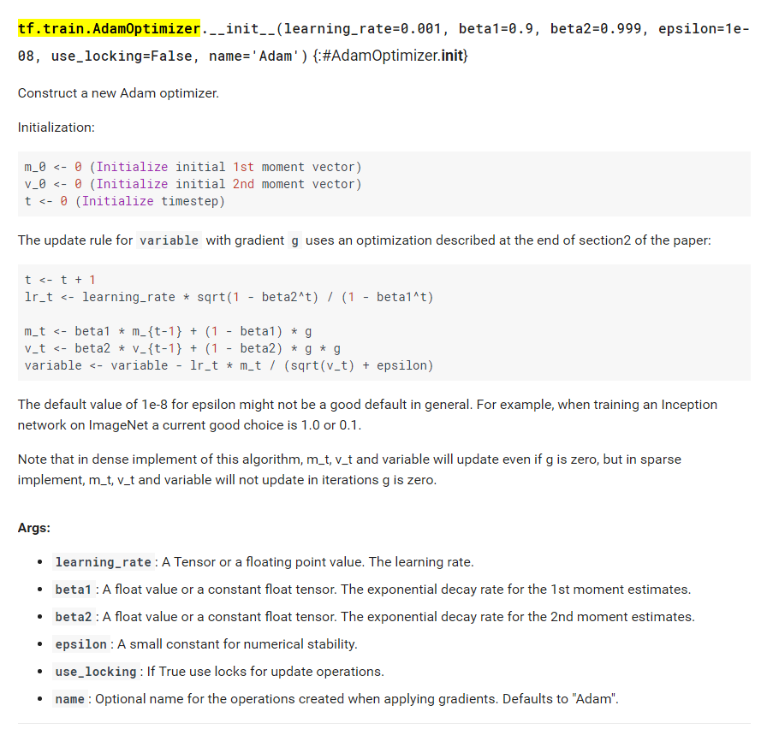
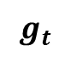
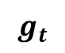
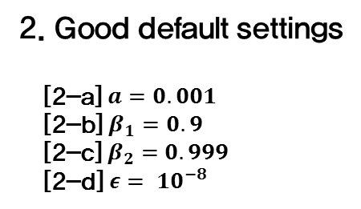
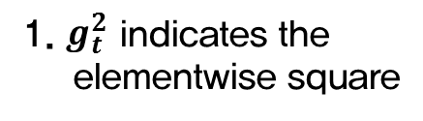
Parameter Updates – Adam
Could you combine RMSProp and Momentum?
1. $g_{t}^{2}$ indicates the elementwise square
$$g_{t}$$
$$g_{t}$$
2. Good default settings
[2-a] $a=0.001$
[2-b] $β_{1}=0.9$
[2-c] $β_{2}=0.999$
[2-d] $ε= {10}^{−8}$
Kingma, Diederik, and Jimmy Ba. "Adam: A method for stochastic optimization." arXiv preprint arXiv:1412.6980 (2014).

Slide 29
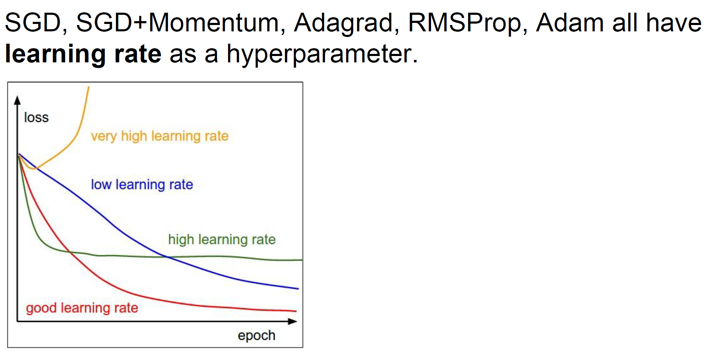
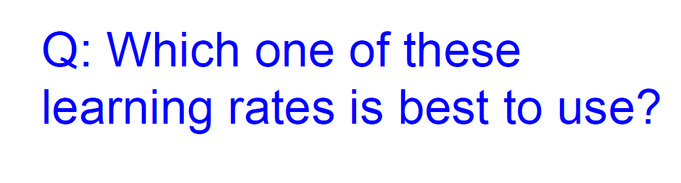
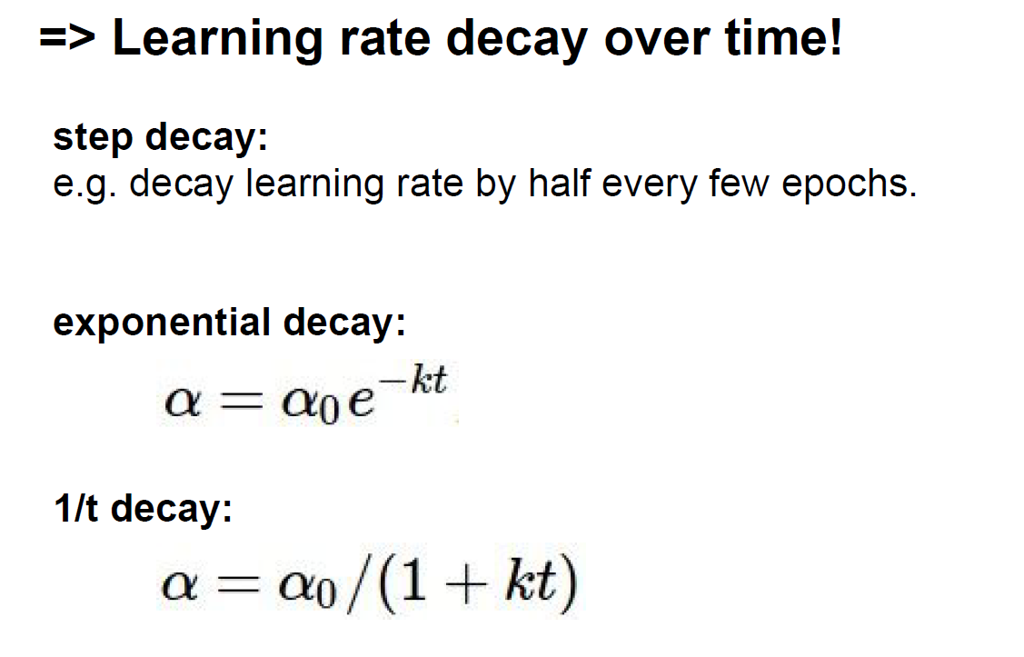
Learning rate decay over time!
Step decay, exponential decay, 1/t decay

Slide 30
Learning rate decay over time!
Step decay, exponential decay, 1/t decay
Usually, in practice using
Exponential decay method

Slide 31
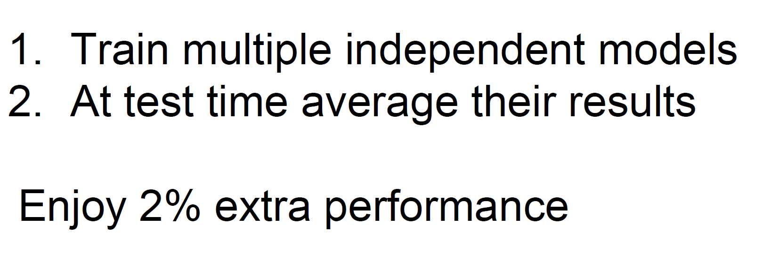
Evaluation : Model Ensembles
2% extra performance...

Slide 32

Evaluation : Model Ensembles
2% extra performance...

Slide 33
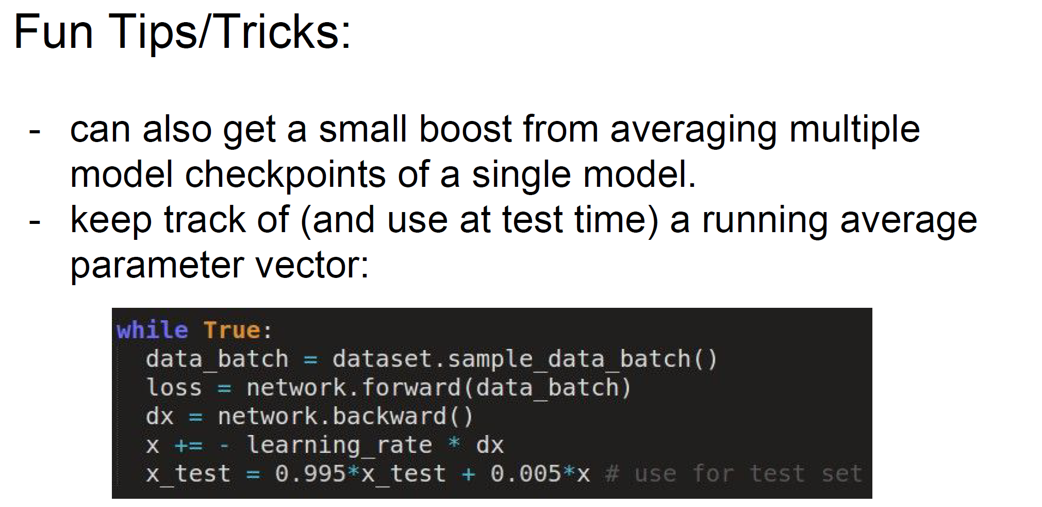
Evaluation : Model Ensembles
If you don’t have much time… (save 'Network weights' during iteration)

Slide 34
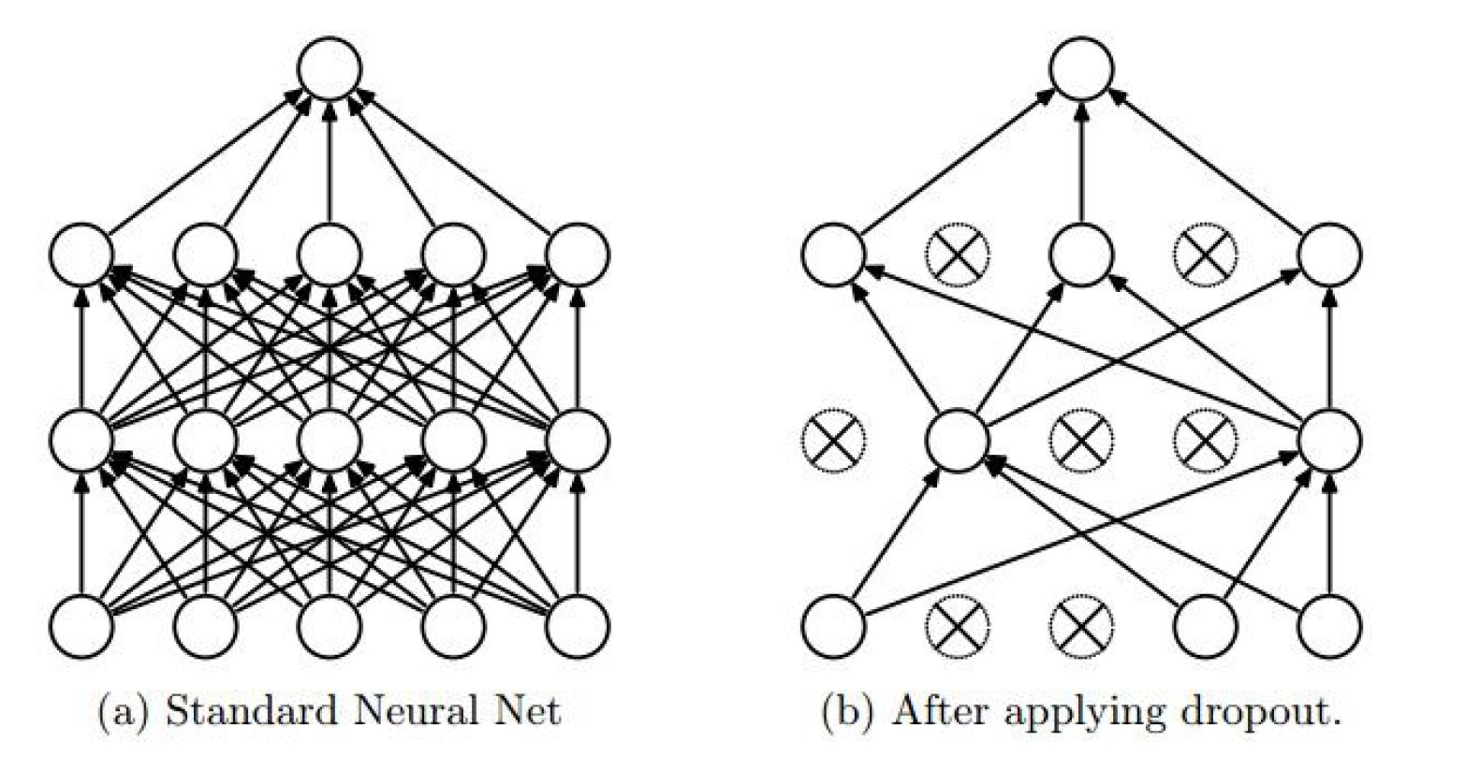
Dropout
Randomly set some neurons to zero in the forward pass

Slide 35
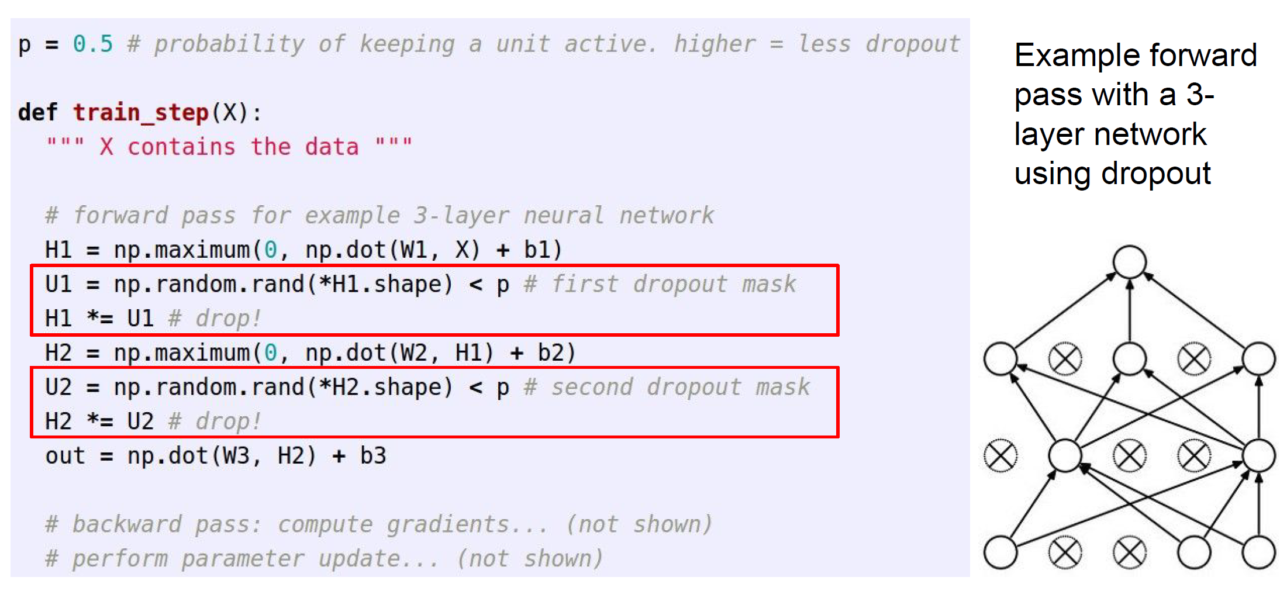
Dropout
Randomly set some neurons to zero in the forward pass
H1 *= U1 (transform boolean value to {0,1})

Slide 36
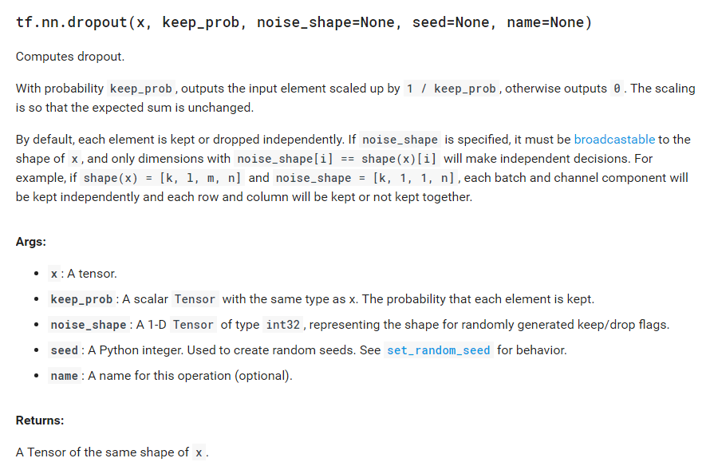
Dropout
In tensorflow..

Slide 37
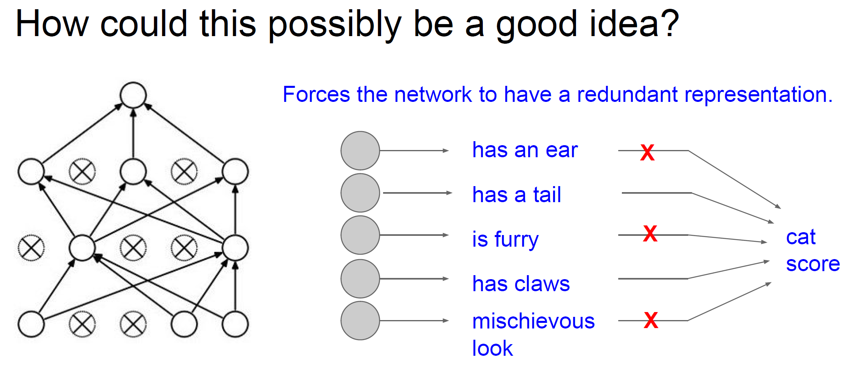
Dropout
‘Whole Network’ is not always better than ‘Reduced network’

Slide 38
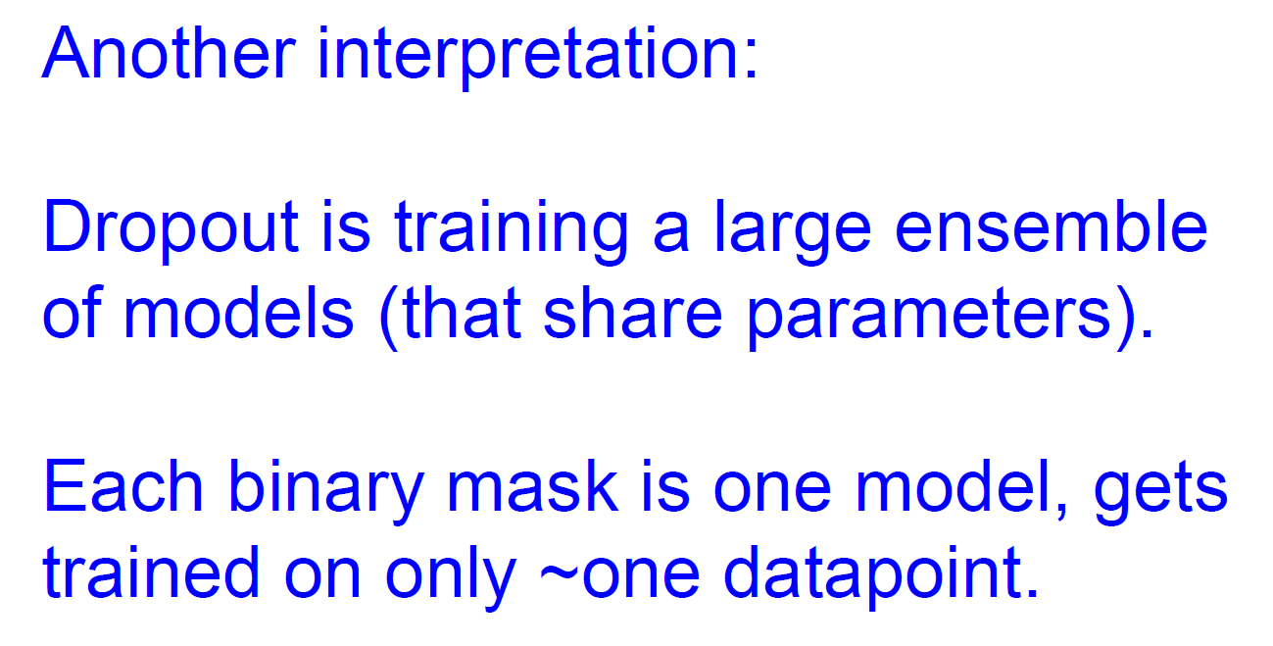
Dropout
‘Whole Network’ is not always better than ‘Reduced network’

Slide 39
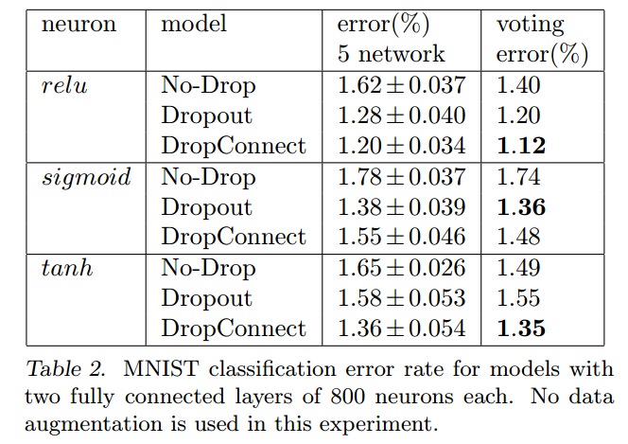
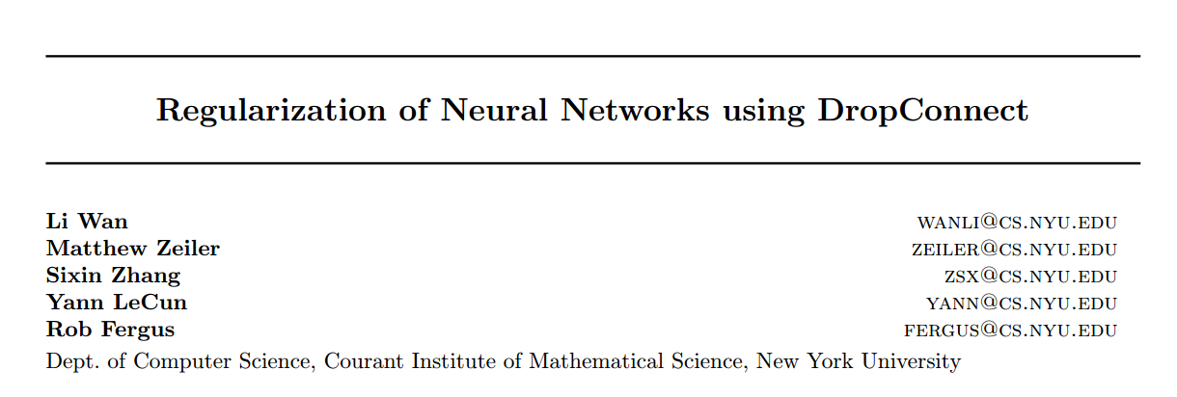
Dropout
Another method is ‘DropConnect’
Wan, Li, et al. "Regularization of neural networks using dropconnect." Proceedings of the 30th International Conference on Machine Learning (ICML-13). 2013.
http://stackoverflow.com/questions/37135885/dropconnect-in-tensorflow/37781180

Slide 40
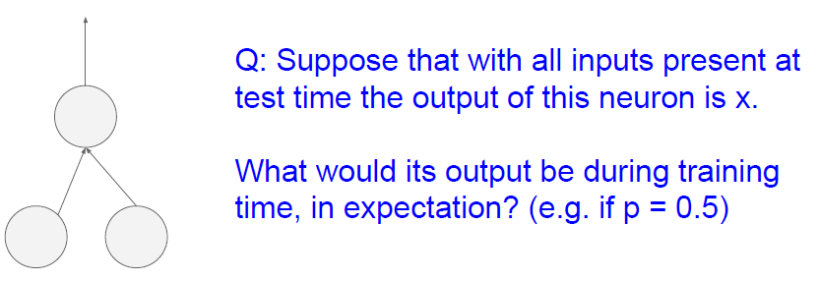
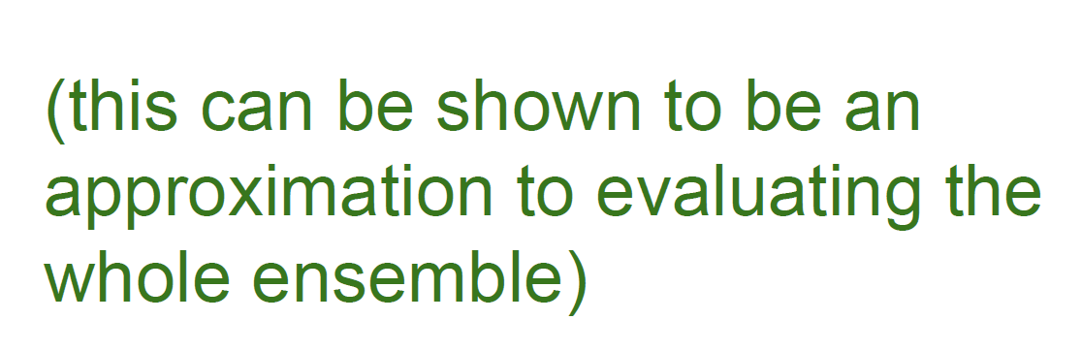
Dropout
Test time..

Slide 41


Dropout
We have to consider time for ‘explode value problem’!
Hinton’s story

Slide 42

Dropout
We have to consider time for ‘explode value problem’!

Slide 43

Dropout
We have to consider time for explode value problem!

Slide 44
Dropout
We have to consider time for ‘explode value problem’!
In tensorflow..

Slide 45




ConvNet are everywhere
ConvNet applications

Slide 46




ConvNet are everywhere
ConvNet applications

Slide 47

ConvNet are everywhere
Are the real ‘CNN’ and ‘Animal brain’ similar?

Slide 48

Let’s GO

